Slide 1
Event Horizon Diagrams

Slide 2
Command
Sub systems
Command Handler
Calls
Event Source
Appends event(s)
Sub systems
Event Store
Event Horizon
Wave functions
Quantum tunnel
Singularity
Other bounded context

Slide 3
Bounded Context: Purchasing
Version 1.0.0
Version 2.0.0
1st Generation
2nd Generation
ProductAdded
ArticleAdded
"name": string
"article": string
Migrator 2nd to 1st
"eventName":"ProductAdded" "properties": {
"article": "name"
}
Bounded Context: Catalog

Slide 4

Notes:
Empower developers to create great sustainable and maintainable software so that they can make their users feel like heroes

Slide 5


«Empower developers to create great, sustainable, maintainable software so that they can make their users feel like heroes.»
Notes:
Empower developers to create great sustainable and maintainable software so that they can make their users feel like heroes

Slide 6
Infrastructure
Digital Twin
Testable
Mobile
Sentiment
Maintainable
Access
Visualization
Bot
Stop words
Microservices
Identity
Provisioning
Billing
Text
GraphQL
Desktop
Tokenization
Model
People Scale
Authorities
Segregation
Assignment
Globalization
REST
Web
Stemming
Training
Architecture
Security
Tenants
Licensing
Localization
API
Interaction
Natural Language
ML
Operating system
Storage
Networking
Deployment
Hosting
Monitoring
Billing
User Satisfaction
Linux
Windows
RDBS
Load Balancing
Build
Containerizing
Uptime
Feedback loop
Document
Routing
A/B Testing
Reliability
Performance
New features
API
DNS
Feature Toggling
SLA
Errors
TLS/SSL
CI / CD
Notes:
This is all the stuff you need to do when building products – Line of Business applications – minimum.
There is a lot more usually as well, but these are at least the things you need to think about.

Slide 7





Focus on delivering business value
Understand
Build
Deliver
Experience
Improve
Notes:
Making people focus on delivering business value – and not solve technical issues.
Moving on from the previous slide we want to make this a lot simpler – let the developer focus on these core steps of their continuous improvement pipeline.

Slide 8
Understand
Domain Driven
Understand the ubiquituous language
Define the bounded contexts
Event Storming

Slide 9
Build
Use Dolittle frameworks
Focus only on the business problems
Descriptive approach
Convention over configuration

Slide 10
Deliver
Push code
Chose strategy for how it should be put into production
Environments; Development, Staging, Production

Slide 11
Experience
Get feedback from users
Monitor solution
Learn so that we can improve the experience for both the end user and the developer
Discover new building blocks

Slide 12
Improve
Improve the platform
Add new services
Add new building blocks
Make it easier for developers to focus on delivering true business value

Slide 13
«There’s a gap between how we know applications should be built, and how we actually build them.»
Notes:
Known principals versus as is writing.
WE as the industry or we as developers in general. Leading experts in the industry
We’ve heard over the years all about different design patterns and approaches from industry leaders such as :
Trygve Reenskaug, MVC 1979 – ASP.NET MVC 2009
Betrand Meyer with CQS in 1988
Domain Driven Design, Eric Evans, 2004 -> Domain Events
Greg Young, CQRS, 2009/2010
Martin Fowler, PresentationModel – MVVM – 2004
eXtreme Programming – late 90's – we're still struggling with it
There is a gap in understanding them individually and looking at them holistically
But there is also a gap in implementation; no frameworks holistically implements all the principles and systemizes it

Slide 14

The 70’s called!
They want their architecture back
Notes:
- A lot of software today is like seeing a hippie-container roll down the street
We’re making architecture on the limitations of 70s hardware
We put everything into the relational database – including code at times, even though it is in fact a compromise – not really awesome at anything
The DB/2 SQL story
Our goto architecture is whatever we find on Google when searching for it; N-tier architecture
We tend to like to DRY things up

Slide 15
Read
Write
Query
Command
ReadModel
WriteModel
Read Models
Write
Models

Slide 16
Client
Client Representations
Query
+ metadata
ReadModel
+ metadata
Command
+ metadata
Server - Read
Server - Write
Query Coordinator
Command Coordinator
Query Security Descriptor
Command Security Descriptor
Query Input Validator
Command Input Validator
Query
Command Business Validator
ReadModel
Command Handler
Event Processor
Event Stream
Event Source
Read Models
Event Store
Memento
= Dolittle
= Custom
= Client Repr.

Slide 17
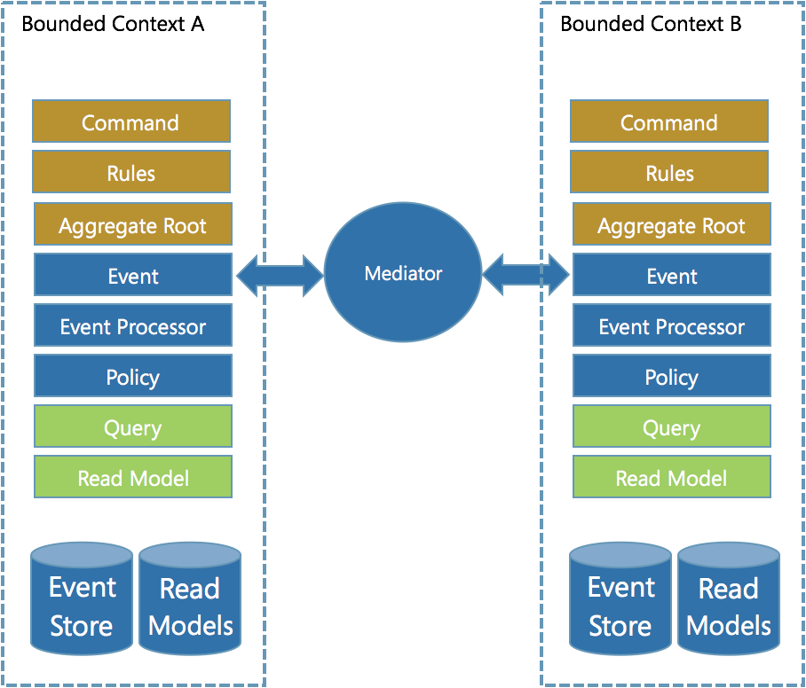

Slide 18









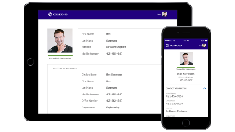
Interaction
SDK
Runtime
Continuous Improvement
Monitoring
Identity, Access, Licensing
Resources
Tenancy
Localization
Billing
Services
MongoDB
SQL
etcd
Search
Index
Kubernetes
Traefik
FluentD
Prometheus
Grafana
Istio
Azure
Storage
Compute
Networking
Reliability
Cognitive

